Slide 1
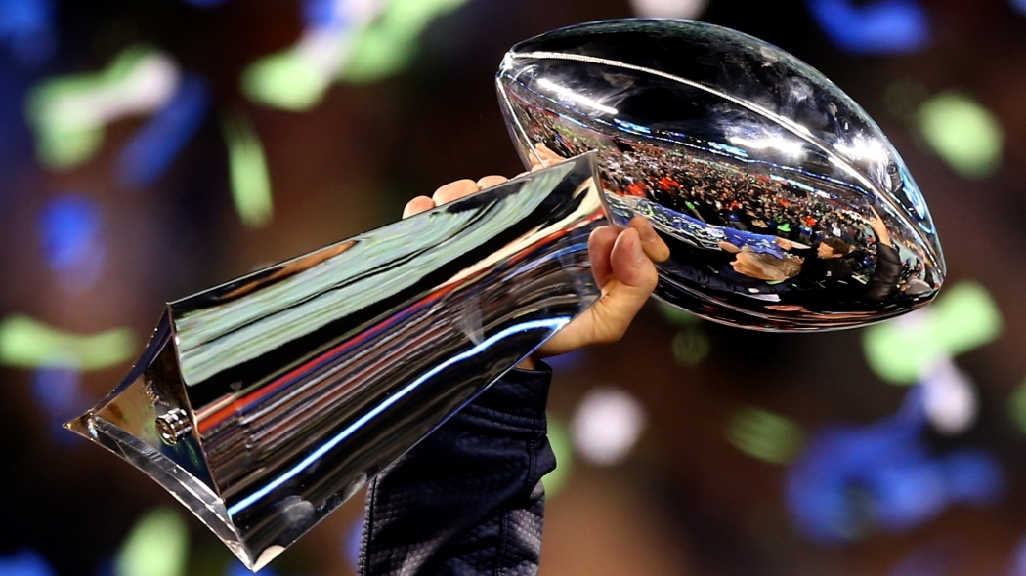
Super Bowl Ads
Stock performance
vs
S&P500
Mike Daniel
Springboard Data Science Career Track
This Photo by Unknown Author is licensed under CC BY-NC-ND

Slide 2
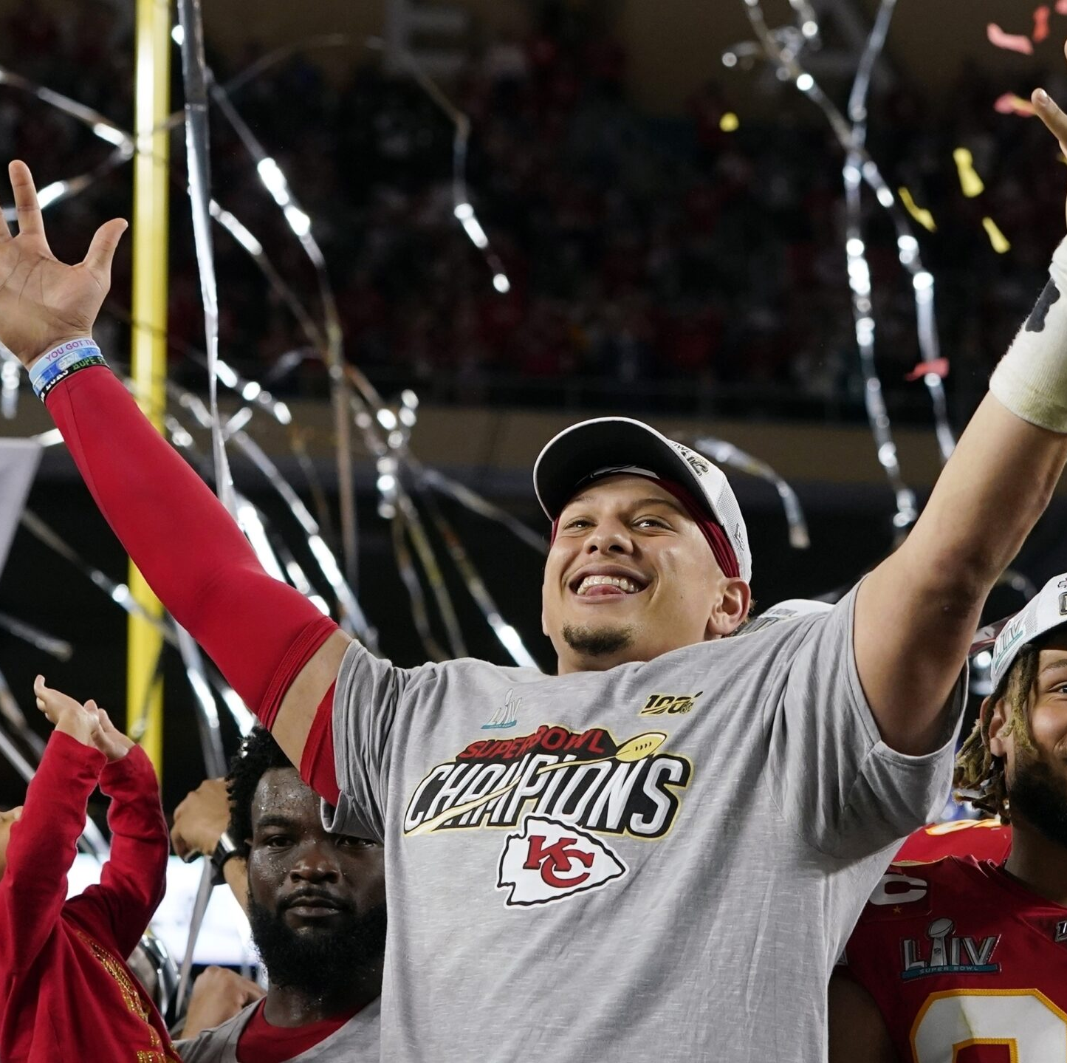
Can Super Bowl advertiser’s stock performance vs S & P 500 be predicted ?
Past research focused on short term performance
Previous studies used only a couple of years of data
Advertisers were more likely to beat the index than not
This Photo by Unknown Author is licensed under CC BY-ND

Slide 3
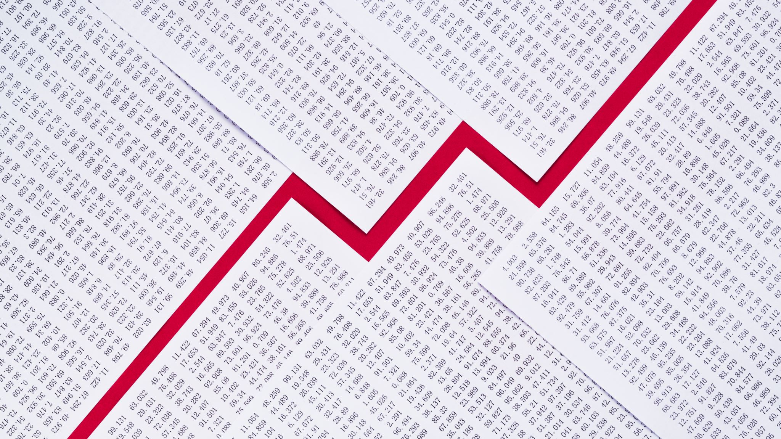
The Data
The data was merged from several data sets.
Text file scraped from https://www.pro-football-reference.com/super-bowl/ (mostly for dates)
From Kaggle https://www.kaggle.com/datasets/prondeau/superbowlads (main data set of 563 Superbowl commercials with the year, product type, product/commercial title, and sometimes a plot)
https://datahub.io/core/employment-us/datapackage.json (general economic information)
Additionally, ChatGPT was used to generate the stock tickers.

Slide 4
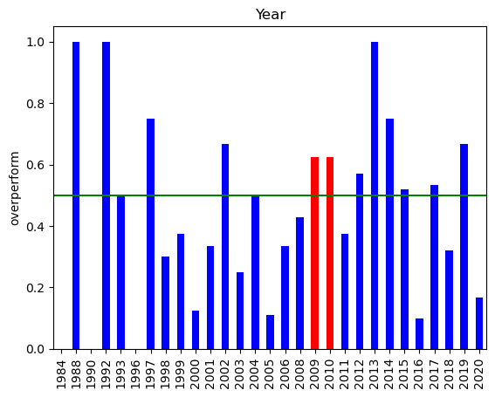
Interesting Turn
Surprisingly, the previous research did appear to have looked at some particularly lucky years, 2009 and 2010
Both years had a 62.5% chance of overperformance while the average of all years was only 43.5%

Slide 5
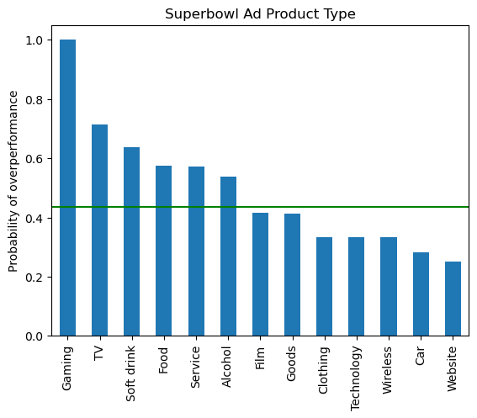
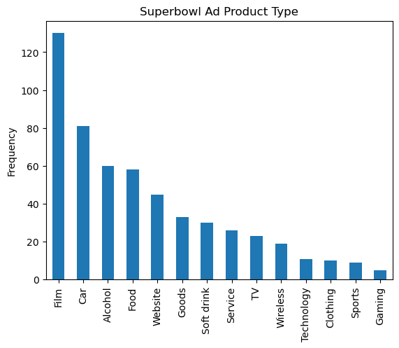
Overperformance by Product Type
There seem to be definite divisions by product type
Food, Soft drink and Alcohol are all above average
Film (but oddly not TV ) and Cars are generally below average
Gaming is a very small sample of ads
Film, car , alcohol and food are about 3 of every 5 ads
Add the similar categories TV and Soft Drink and it is closer to 3 in 4 ads

Slide 6
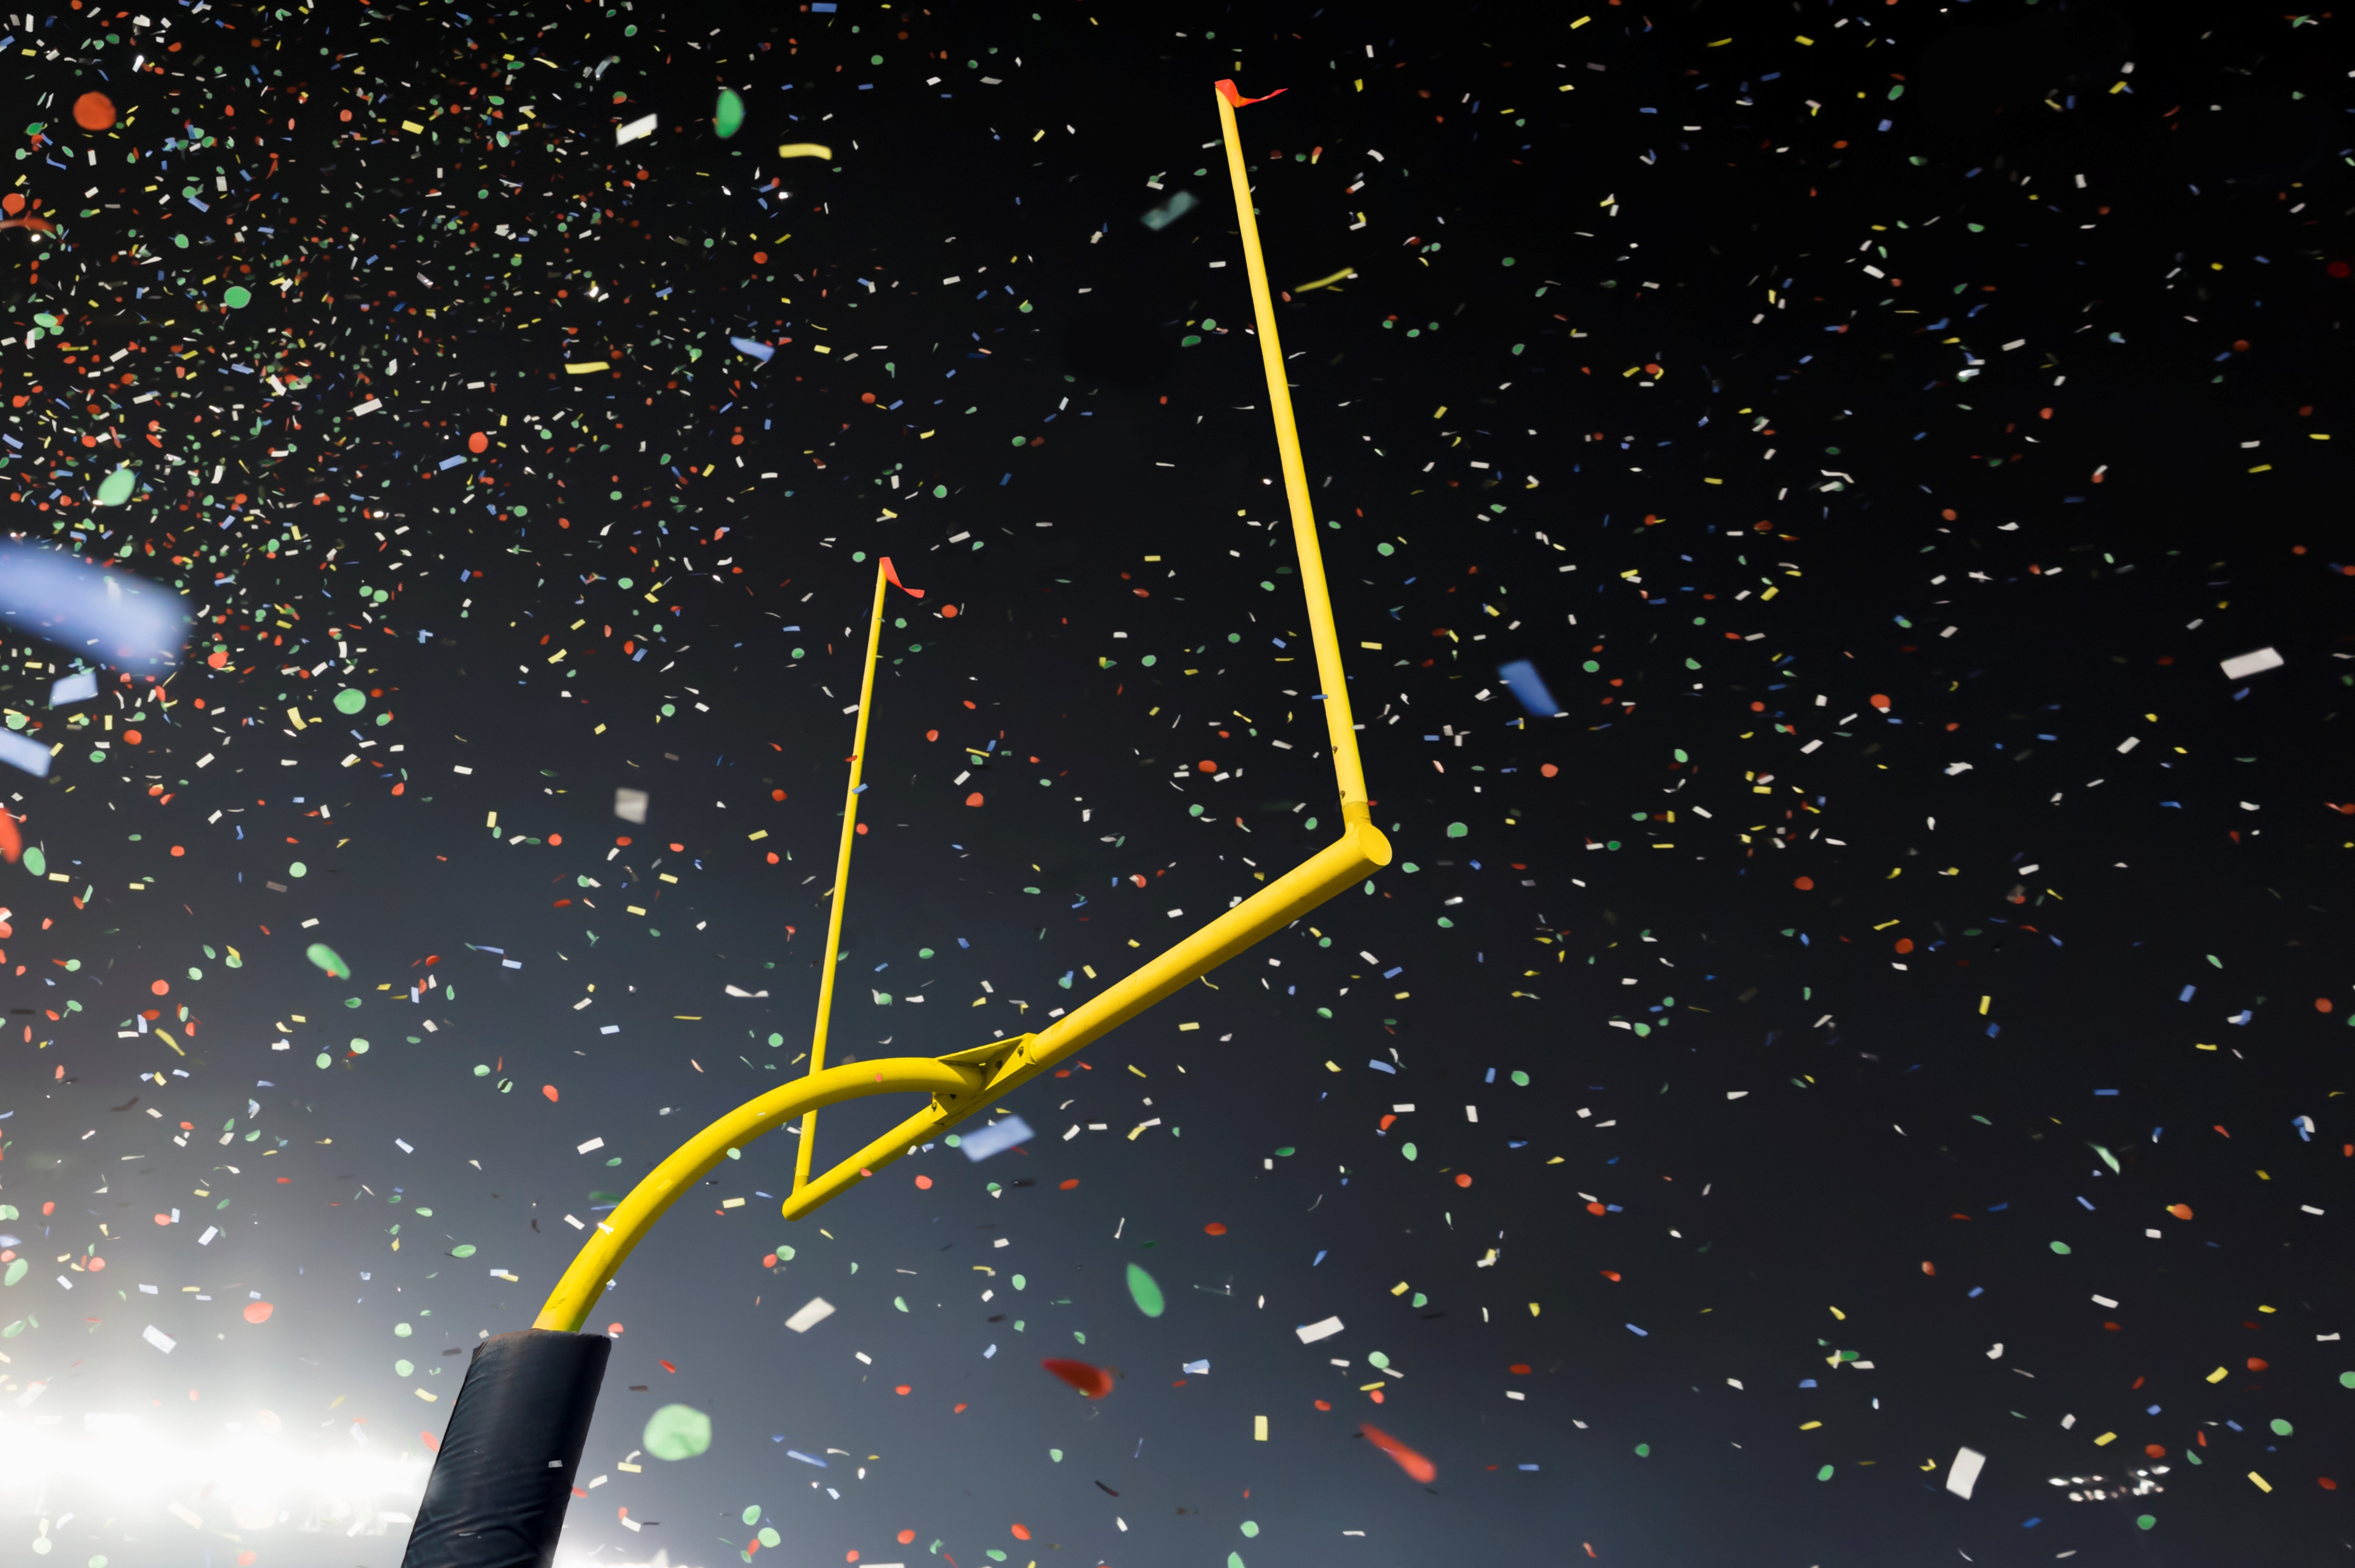
Model plan Try out several models to predict the target ‘overperform’: Logistic Regression KNN SVM Random Forest Gradient Boosting
Numeric features
market cap shares outstanding
Year year incorporated
Previous Superbowl Ad CPI
Yearly Ad Count
Ave inflation rate New Advertiser
USD per euro Change in GDP
VIX Change in businesses
Categorical features
Product type Ticker

Slide 7
Model comparison
 | Algorithm | Mean cross validation training score | Mean cross validation test score | Standard deveation in cross validation
 | Logistic Regression | 0.609158 | 0.511905 | 0.111955
 | KNN | 0.510451 | 0.672619 | 0.144881
 | SVM | 0.575399 | 0.623333 | 0.138484
 | Random Forest | 0.570719 | 0.597619 | 0.084213
 | Gradient Boost | 0.582257 | 0.572619 | 0.101707
The best test score is with KNN but also the most variable
Random Forest and Gradient Boosting seem to be the most consistent
Logistic regression may be overfitting

Slide 8
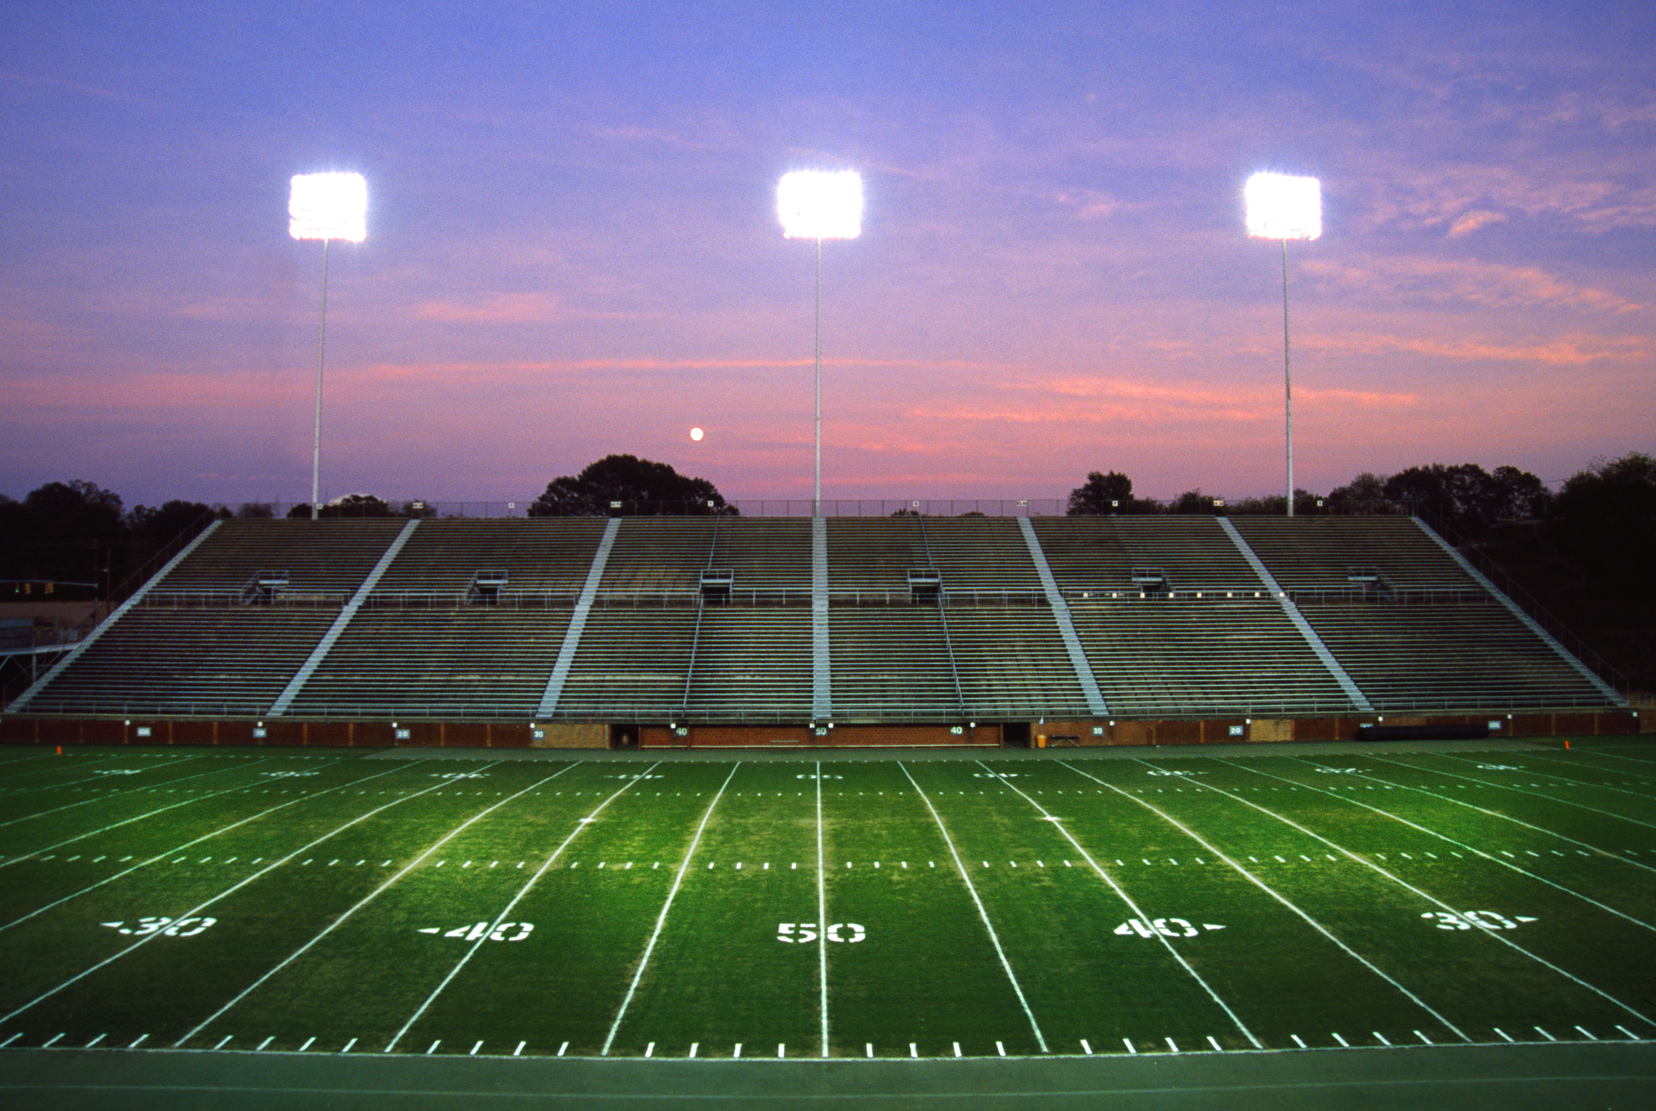
Modelling Choices
Random Forest is the most consistent and is the choice of model
Tuned the Random Forest , Gradient Boosting and K-nearest Neighbor Classifiers
Used 5-fold GridSearch and Cross-validation
 | Algorithm | ROC-AUC test score | ROC-AUC test Algorithm std
 | KNN | 0.54 | 0.13
 | Random Forest | 0.60 | 0.10
 | Gradient Boost | 0.47 | 0.11

Slide 9

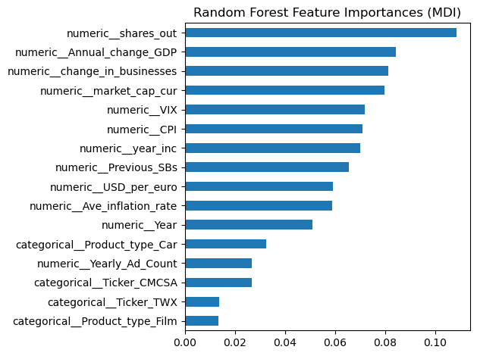
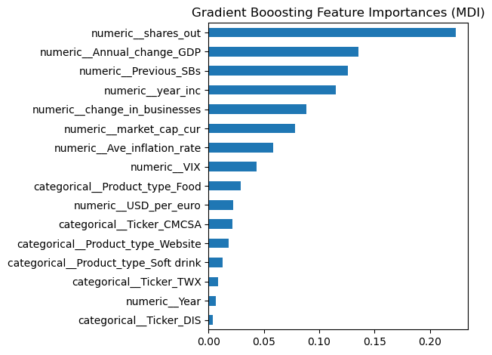
Feature Importance
The top features are the numerical features, and they are mostly the same in both models
The Gradient Boosting model weights the top features more heavily, explaining the higher variability in the model and confirming the Random Forest model as the better choice
Two stocks Comcast and Time Warner in the Product types Film and TV are of particular interest
Product types Film and Car (Random Forest) and Food and Soft Drink(Gradient Boosting) also appear to be relevant

Slide 10

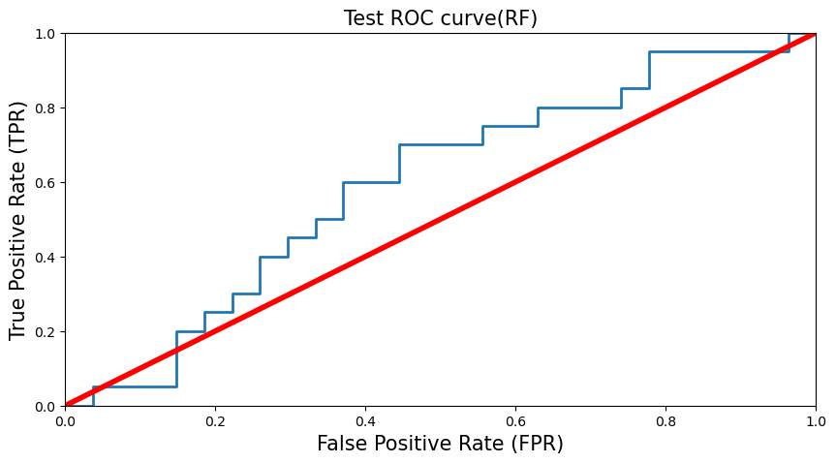
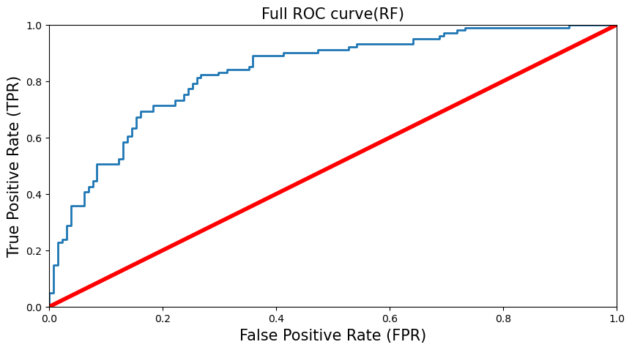
Results
Test Set | Precision | Recall | f1 | support
0 | 0.59 | 0.81 | 0.69 | 27
1 | 0.50 | 0.25 | 0.33 | 20
The model is much better at identifying the underperformers but takes a very cautious approach to picking overperformers
Full Set | Precision | Recall | f1 | support
0 | 0.71 | 0.88 | 0.78 | 131
1 | 0.77 | 0.52 | 0.62 | 101
The model shows clear improvement over random guessing
Between picking all to overperform or none to overperform, picking none is surprisingly the better option
The model improves on both the passive(picking none) and aggressive(picking all) strategies in terms of the ‘overperform’ metric

Slide 11
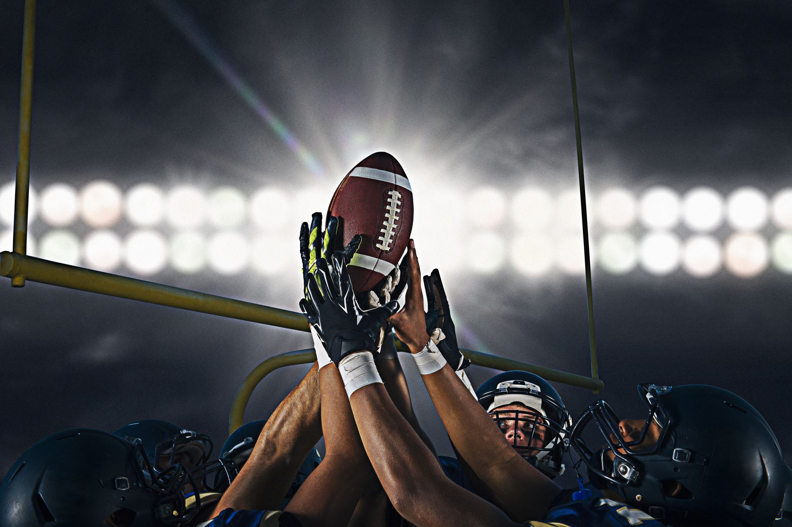
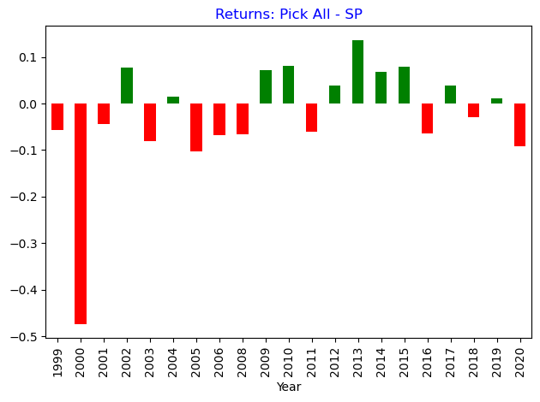
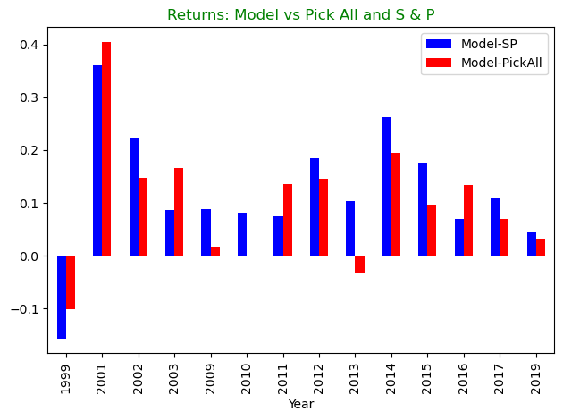
Returns
The original idea of picking all the Super Bowl Advertisers only beats the S & P 500 10 of the 21 years 1999 to 2020
The model did not predict any overperformers in the years:
2000, 2004, 2005, 2006, 2008, 2018, 2020
The average return of the model in the other years is 15.89% while the S & P only averaged 2.57% and the pick all strategy averaged 7.06% in those years

Slide 12
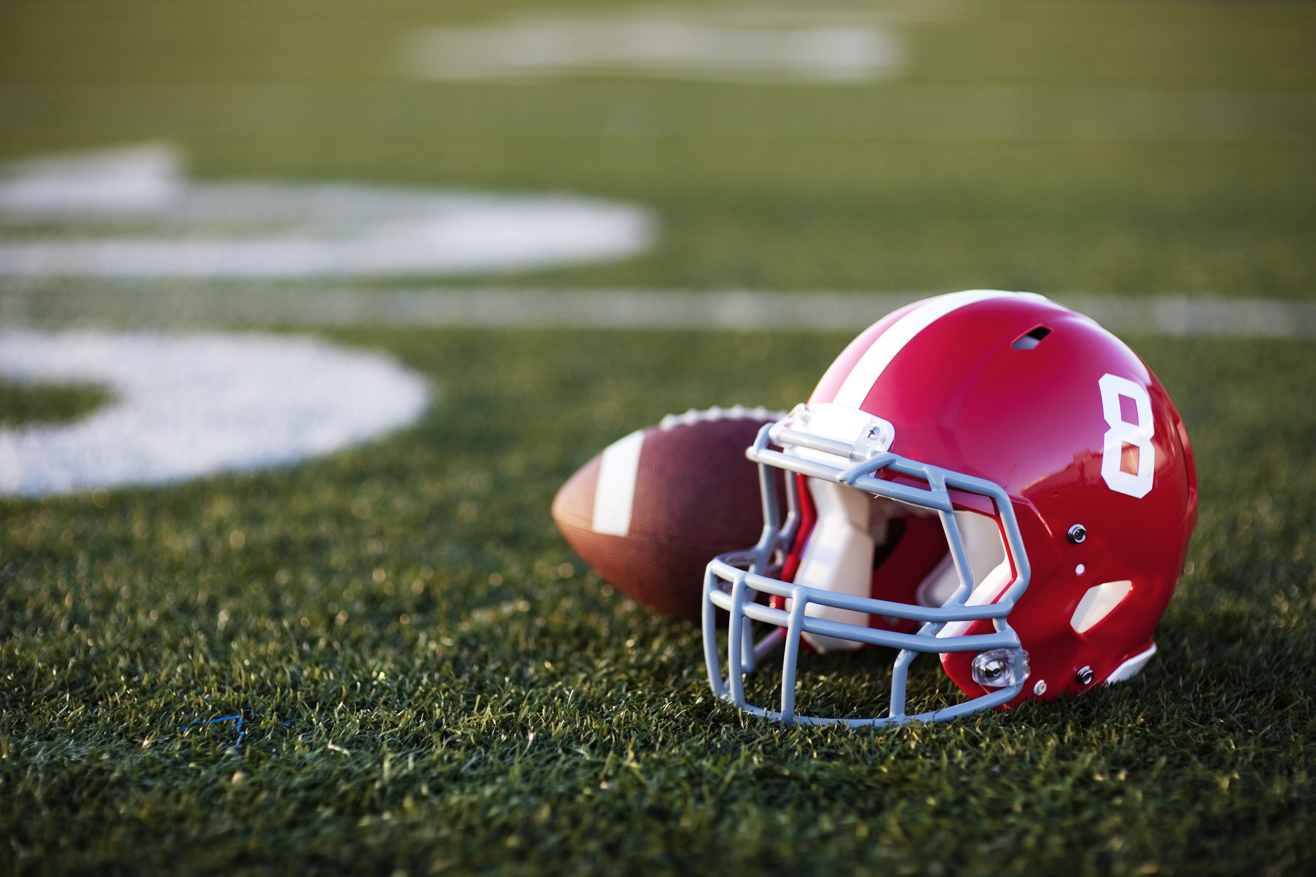
Off years
Year | S and P | Pick All | PickAll-SP
2000 | 2.6% | -44.7% | -47.3%
2004 | -2.5% | -1.1% | 1.4%
2005 | 1.8% | -8.6% | -10.3%
2006 | 0.8% | -6.0% | -6.8%
2008 | -9.5% | -16.2% | -6.7%
2018 | 7.6% | 4.8% | -2.9%
2020 | 1.4% | -7.8% | -9.2%
The years the model did not choose any stocks to overperform were typically good years to sit out.
2000 was the tech bubble crashing, 2008 was the housing crash, and 2020 was Covid.
2018 was the only remotely good year the model missed out on.
Limitations
Data for some years was sparse or incomplete
The models had less than optimal variability under CV
The model tended to be better at weeding out the ‘losers’ than picking as many ‘winners’.

Slide 13
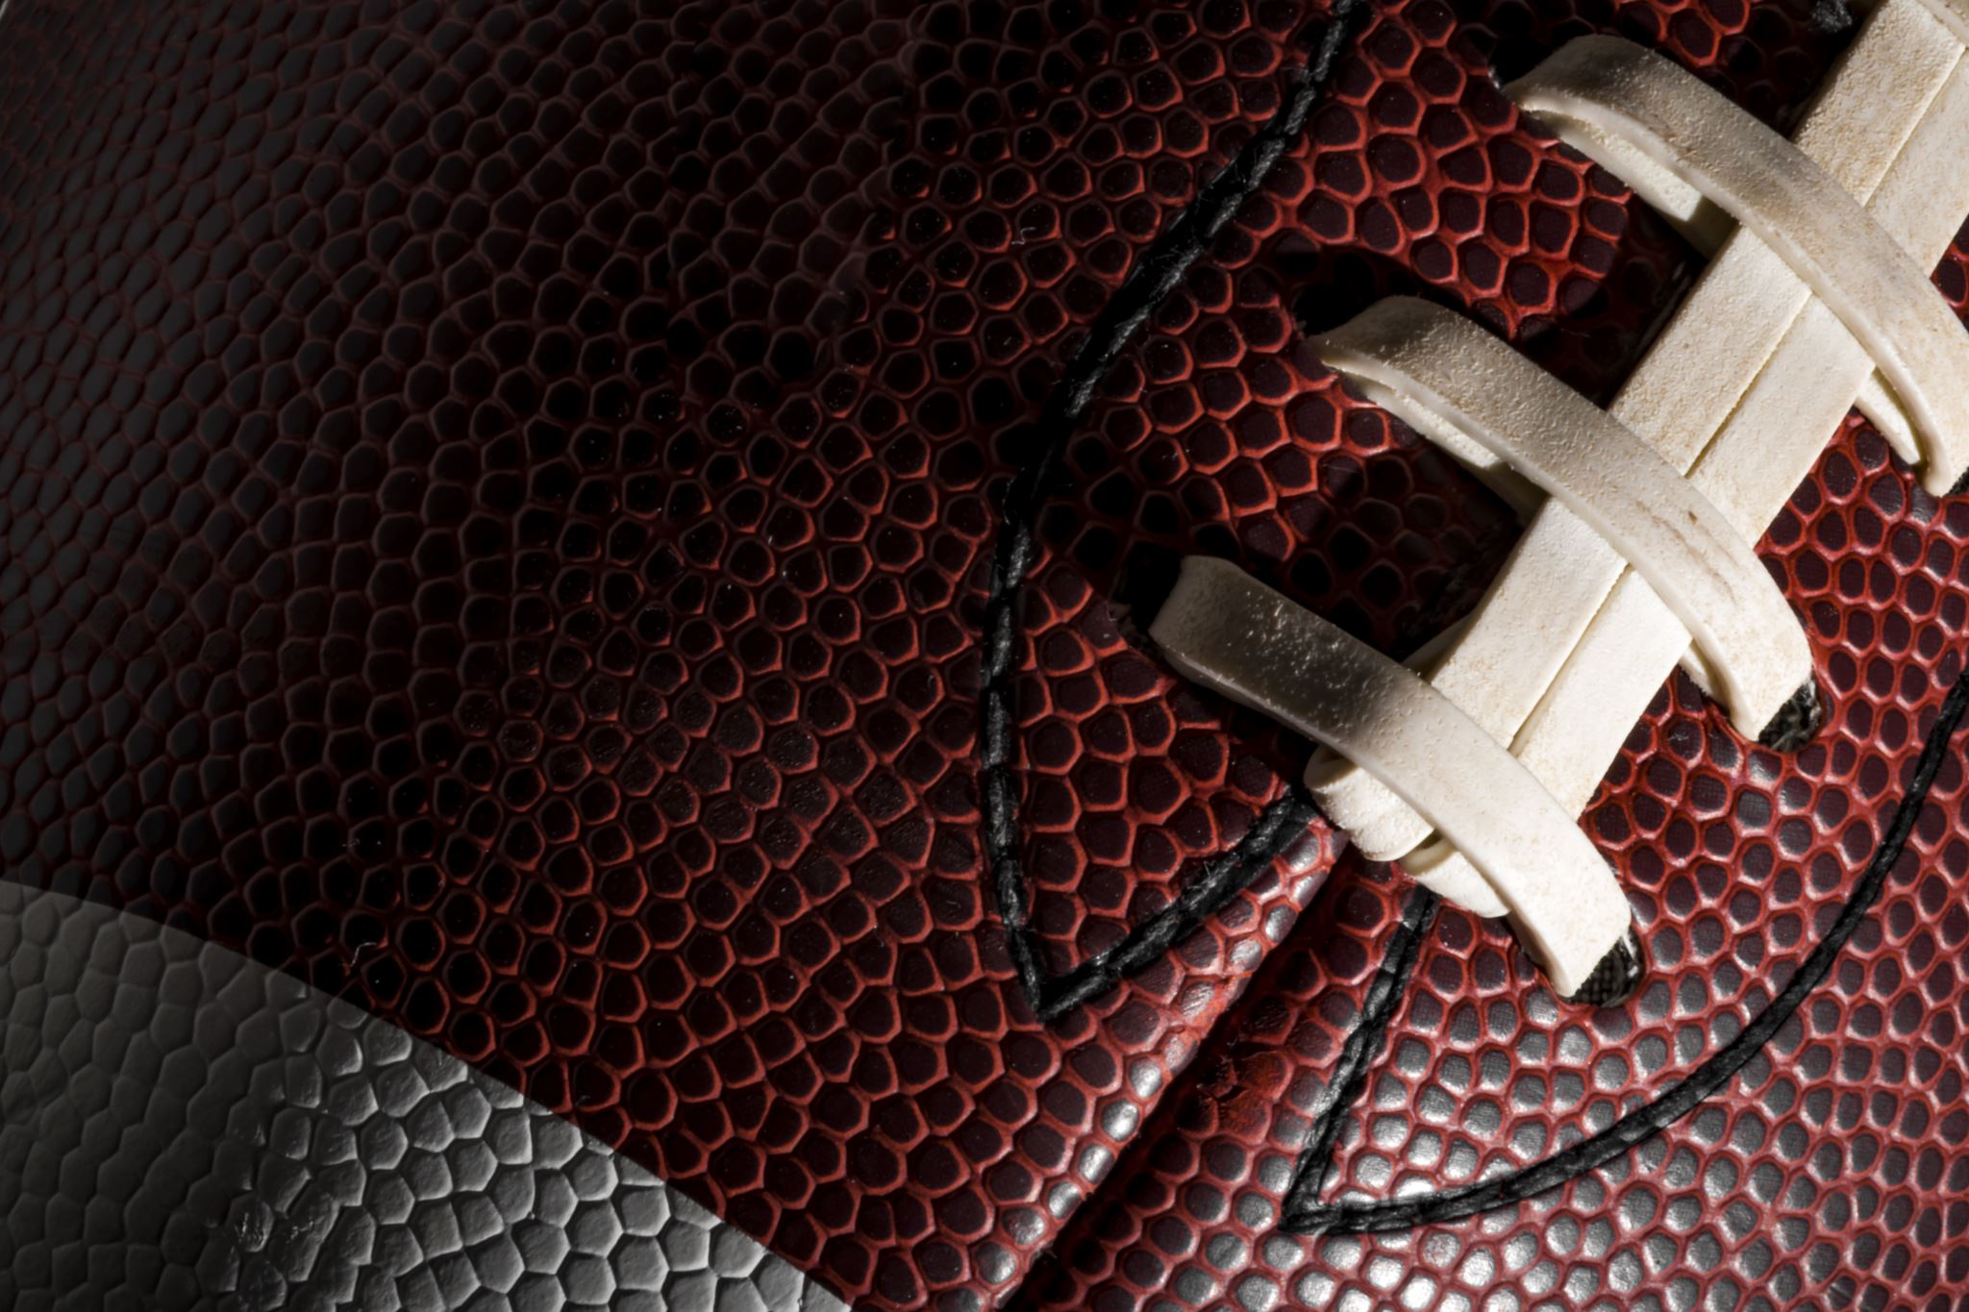
Future work
Create a more comprehensive data set by scraping the data again
Refine better product types as these seemed to be highly relevant
Extract additional features regarding company advertising budgets, sales, and more specific public corporate accounting reports
Test the current model using 2021 and 2022 data
Thanks to Springboard and especially my mentor Kevin Ding

